Slide 1
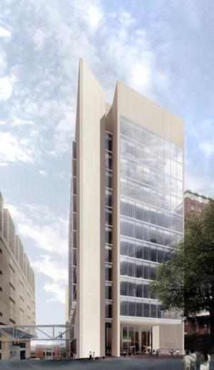
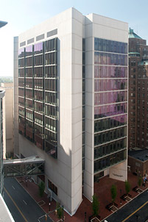
Introduction
James W. & Frances G. McGlothlin Medical Education Center
Virginia Commonwealth University School of Medicine
(VCU SOM)
Richmond, VA
Marissa Delozier
{Structural Option}
Faculty Consultant: Hanagan

Slide 2
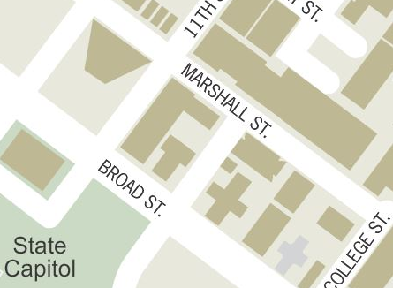
VCU SOM
Building Statistics
Project Overview
Proposal
Gravity System
Redesign
Vibration Control
Lateral System
Moment Frame Layout
RAM Model
Cost & Schedule Analysis
Architectural Impacts
Conclusions
220, 000 GSF
13 stories above ground
Multipurpose (Admin, Classrooms, Labs)
$159 million
October 2009 to March 2013
Designed for LEED Silver Certification

Slide 3
VCU SOM
Primary Project Team
Project Overview
Proposal
Gravity System
Redesign
Vibration Control
Lateral System
Moment Frame Layout
RAM Model
Cost & Schedule Analysis
Architectural Impacts
Conclusions
Notes:
Owner – Virginia Commonwealth University
CM – Gilbane Building Company
Architect + Engineers – Ballinger
Exterior Architect – Pei Cobb Freed & Partners
Civil Engineer – Draper Aden Associates
Geotechnical Engineers – Geotech, Inc.

Slide 4
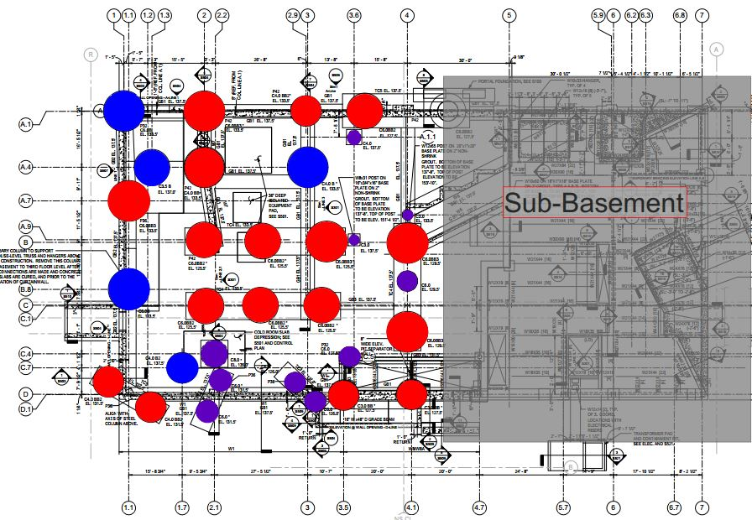
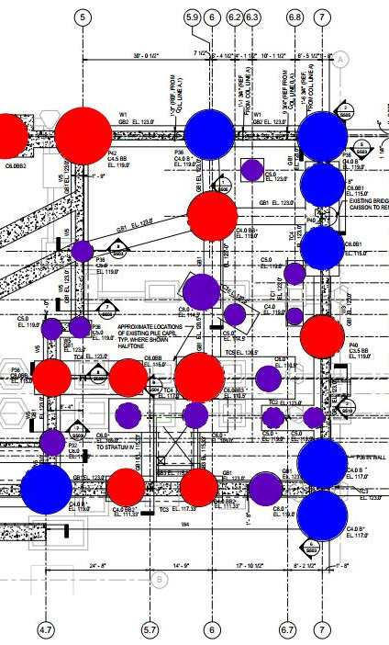
VCU SOM
Existing Gravity System
Project Overview
Proposal
Gravity System
Redesign
Vibration Control
Lateral System
Moment Frame Layout
RAM Model
Cost & Schedule Analysis
Architectural Impacts
Conclusions
Drilled piers + caisson-grade beam system
N

Slide 5
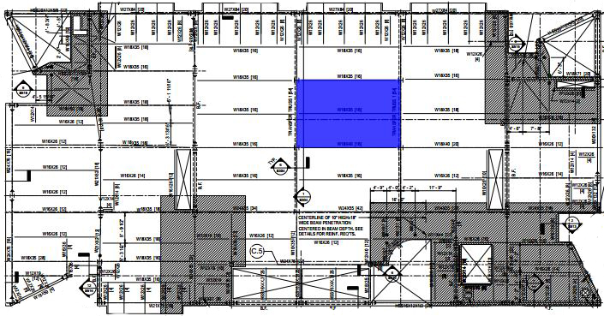
VCU SOM
Existing Gravity System
Project Overview
Proposal
Gravity System
Redesign
Vibration Control
Lateral System
Moment Frame Layout
RAM Model
Cost & Schedule Analysis
Architectural Impacts
Conclusions
Drilled piers + caisson-grade beam system
Composite Steel Flooring
3” 20 gauge decking
3 ½” LW concrete topping
Wide Flange Steel Beams + Girders
Typical Bay Sizes
30’ x 20’
30’ x 40’
N

Slide 6
VCU SOM
Existing Lateral System
Project Overview
Proposal
Gravity System
Redesign
Vibration Control
Lateral System
Moment Frame Layout
RAM Model
Cost & Schedule Analysis
Architectural Impacts
Conclusions
Concentrically braced frames + moment connections
7 total, majority in one direction
Both wide flange + HSS
N

Slide 7
VCU SOM
Opportunities
Project Overview
Proposal
Gravity System
Redesign
Vibration Control
Lateral System
Moment Frame Layout
RAM Model
Cost & Schedule Analysis
Architectural Impacts
Conclusions
Increase efficiency of structural system
Save both time + money
In line with VCU SOM reinvented curriculum, create open environments

Slide 8
VCU SOM
Opportunities
Proposal
Project Overview
Proposal
Gravity System
Redesign
Vibration Control
Lateral System
Moment Frame Layout
RAM Model
Cost & Schedule Analysis
Architectural Impacts
Conclusions
Increase efficiency of structural system
Save both time + money
In line with VCU SOM reinvented curriculum, create open environments
Design alternate structural system
Non-composite deck + K-series joists + girders
Heavier emphasis on use of moment frames
Evaluate cost + schedule of redesign
Structural Costs vs. Total Project Costs
Investigate impacts on Architecture
Can a more open concept be achieved?
Can improvements be made?

Slide 9
VCU SOM
Gravity System
Project Overview
Proposal
Gravity System
Redesign
Vibration Control
Lateral System
Moment Frame Layout
RAM Model
Cost & Schedule Analysis
Architectural Impacts
Conclusions
Possible Bay Configurations
30’ x 20’ – Joists traveling in 30’ direction
30’ x 40’ – Joists traveling in 30’ direction
30’ x 20’ – Joists traveling in 20’ direction
30’ x 40’ – Joists traveling in 40’ direction
40’
30’

Slide 10
VCU SOM
Gravity System
Hand Calculations
Project Overview
Proposal
Gravity System
Redesign
Vibration Control
Lateral System
Moment Frame Layout
RAM Model
Cost & Schedule Analysis
Architectural Impacts
Conclusions
Possible Bay Configurations
30’ x 20’ – Joists traveling in 30’ direction
30’ x 40’ – Joists traveling in 30’ direction
30’ x 20’ – Joists traveling in 20’ direction
30’ x 40’ – Joists traveling in 40’ direction
Layout | Decking | Joists | Girders
I | 1.0C24 | 22K10 | W18x35
II | 1.0C24 | 22K10 | W24x146
III | 0.6C24 | 14K4 | W24x68
IV | 0.6C24 | 26K12 | W24x76

Slide 11
VCU SOM
Gravity System
Project Overview
Proposal
Gravity System
Redesign
Vibration Control
Lateral System
Moment Frame Layout
RAM Model
Cost & Schedule Analysis
Architectural Impacts
Conclusions
Layout | Bay Size | Walking Evaluation < 0.5 % g | Floor Stiffness < 9 Hz | Final Evaluation
I | 30’x20’ | 0.47 % g | 5.47 Hz | Pass
II | 30’x40’ | 0.28 % g | 3.54 Hz | Pass
III | 30’x20’ | 0.38 % g | 4.77 Hz | Pass
40’
IV | 30’x40’ | 0.58 % g | 3.93 Hz | Fail
30’

Slide 12
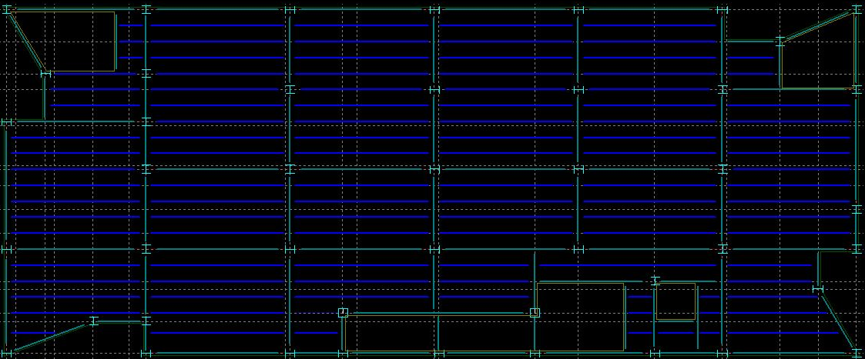
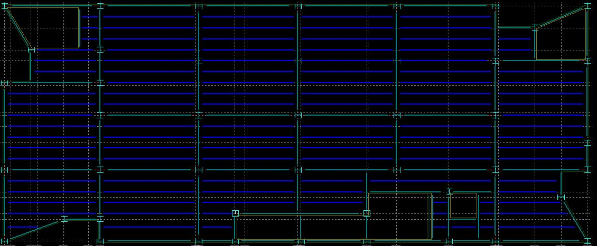
VCU SOM
Gravity System – Final Redesign
Project Overview
Proposal
Gravity System
Redesign
Vibration Control
Lateral System
Moment Frame Layout
RAM Model
Cost & Schedule Analysis
Architectural Impacts
Conclusions
Layout | Bay Size | Decking | Joists | Girders
I | 30’x20’ | 1.0C24 | 22K10 | W18x40
Layout | Bay Size | Decking | Joists | Girders
II | 30’x40’ | 1.0C24 | 22K10 | W30x124

Slide 13
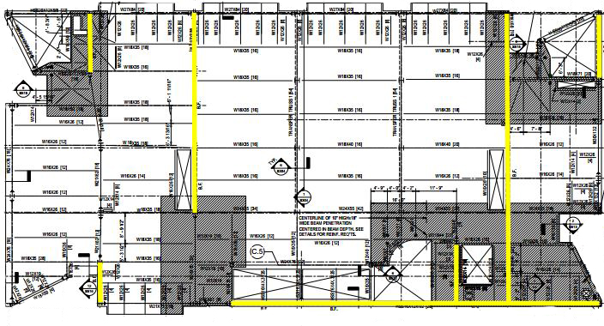
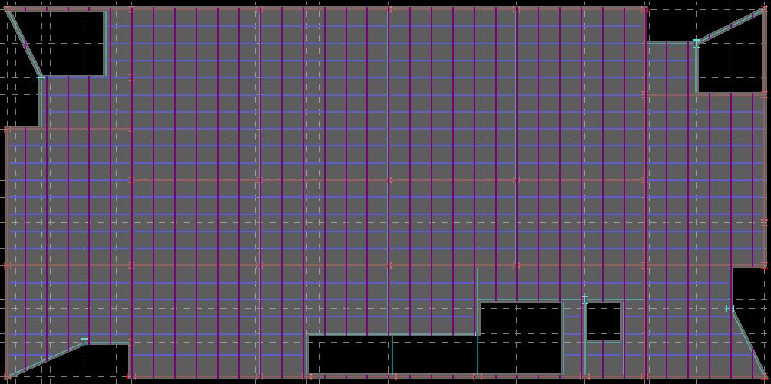
VCU SOM
Lateral System
Project Overview
Proposal
Gravity System
Redesign
Vibration Control
Lateral System
Moment Frame Layout
RAM Model
Cost & Schedule Analysis
Architectural Impacts
Conclusions
Existing Lateral System – Braced Frames
Proposed Lateral System – Moment
Braced
N

Slide 14
VCU SOM
RAM Model
Project Overview
Proposal
Gravity System
Redesign
Vibration Control
Lateral System
Moment Frame Layout
RAM Model
Cost & Schedule Analysis
Architectural Impacts
Conclusions
Center of Mass + Center of Rigidity
Center of Mass (88, 43.5)
Center of Rigidity (91, 39)

Slide 15
VCU SOM
RAM Model
Maximum Drifts
Project Overview
Proposal
Gravity System
Redesign
Vibration Control
Lateral System
Moment Frame Layout
RAM Model
Cost & Schedule Analysis
Architectural Impacts
Conclusions
Center of Mass + Center of Rigidity
Drift Checks
Wind Loadings – Case 1 Controls
Seismic Loadings
Loading | Drift | Allowable Drift
Wind – Case 1 | 0.42 | 0.44
Wind – Case 2 | 0.32 | 0.44
Wind – Case 3 | 0.32 | 0.44
Wind – Case 4 | 0.25 | 0.44
Seismic | 0.62 | 2.9

Slide 16
VCU SOM
Frame Participation
Proposed Lateral System
Project Overview
Proposal
Gravity System
Redesign
Vibration Control
Lateral System
Moment Frame Layout
RAM Model
Cost & Schedule Analysis
Architectural Impacts
Conclusions
Frame # | 1 | 2 | 3 | 4 | 5 | 6
Avg. Load | 20% | 32% | 20% | 5% | 5% | 18%
6
5
4
3
2
1

Slide 17
VCU SOM
Frame Participation
Proposed Lateral System
Project Overview
Proposal
Gravity System
Redesign
Vibration Control
Lateral System
Moment Frame Layout
RAM Model
Cost & Schedule Analysis
Architectural Impacts
Conclusions
Frame # | 1 | 2 | 3 | 4 | 5 | 6
Avg. Load | 20% | 32% | 20% | 5% | 5% | 18%
6
5
4
3
Frame # | 7 | 8 | 9 | 10
Avg. Load | 5% | 54% | 15% | 26%
7
8
9
10
2
1

Slide 18
VCU SOM
Project Overview
Proposal
Gravity System
Redesign
Vibration Control
Lateral System
Moment Frame Layout
RAM Model
Cost & Schedule Analysis
Architectural Impacts
Conclusions
Cost & Schedule Analysis
{Breadth 1}

Slide 19
VCU SOM
Cost & Schedule Analysis
{Breadth 1}
Project Overview
Proposal
Gravity System
Redesign
Vibration Control
Lateral System
Moment Frame Layout
RAM Model
Cost & Schedule Analysis
Architectural Impacts
Conclusions
Original System
Concrete | $ 1.16
Conc. Placing | $ 0.25
Conc. Finishing | $ 0.14
Shear Studs | $ 0.16
Beams | $ 4.20
Girders | $ 11.72
Decking | $ 2.80
Fireproofing | $ 0.81
Total ($/SF) | $ 21.23
Redesigned System
Concrete | $ 1.25
Conc. Placing | $ 0.18
Conc. Finishing | $ 0.67
K-Series Joists | $ 3.41
Girders | $ 8.17
Decking | $ 2.22
Fireproofing | $ 1.70
Total ($/SF) | $ 17.61
Structural System Costs
Total Project Costs
Curtain Wall Changes
Additional Fireproofing
Schedule Comparison

Slide 20
VCU SOM
Cost & Schedule Analysis
{Breadth 1}
Project Overview
Proposal
Gravity System
Redesign
Vibration Control
Lateral System
Moment Frame Layout
RAM Model
Cost & Schedule Analysis
Architectural Impacts
Conclusions
Structural System Costs
Total Project Costs
Curtain Wall Changes
Additional Fireproofing
Schedule Comparison
System | Floor-to-Floor | Ceiling Ht | Total Height
Original | 14’ – 8” | 11’ – 0” | 196’ – 0”
Redesign Option 1 | 14’ – 8” | 10’ – 6” | 196’ – 0”
Redesign Option 2 | 15’ – 2” | 11’ – 0” | 202’ – 6”
Notes:
Option 1 – Same Floor-to-Floor Height (vs Original)
Option 2 – Same Ceiling Height (vs Original)

Slide 21
VCU SOM
Cost & Schedule Analysis
{Breadth 1}
Project Overview
Proposal
Gravity System
Redesign
Vibration Control
Lateral System
Moment Frame Layout
RAM Model
Cost & Schedule Analysis
Architectural Impacts
Conclusions
Structural System Costs
Total Project Costs
Curtain Wall Changes
Additional Fireproofing
Schedule Comparison
System | Original
Decking | Meets 2 HR
Steel | Spray
Ceiling | Non-Rated
Sprinkler | Yes
Price Increase | –
Redesign – A
Meets 2 HR
Spray
Non-Rated
Yes
$ 0.92/SF
Redesign – B
Meets 2 HR
Factory Applied+Spray
Rated
No
$ 1.20/SF

Slide 22
VCU SOM
Cost & Schedule Analysis
{Breadth 1}
Project Overview
Proposal
Gravity System
Redesign
Vibration Control
Lateral System
Moment Frame Layout
RAM Model
Cost & Schedule Analysis
Architectural Impacts
Conclusions
Task | Original Duration | Redesign Duration
Steel Erecting + Detailing | 122 days | 114 days
Deck Pour/ Fireproofing | 89 days | 93 days
Structural System Costs
Total Project Costs
Curtain Wall Changes
Additional Fireproofing
Schedule Comparison

Slide 23
VCU SOM
Project Overview
Proposal
Gravity System
Redesign
Vibration Control
Lateral System
Moment Frame Layout
RAM Model
Cost & Schedule Analysis
Architectural Impacts
Conclusions
Architectural Impacts
{Breadth 2}

Slide 24
VCU SOM
Architectural Impacts
{Breadth 2}
Project Overview
Proposal
Gravity System
Redesign
Vibration Control
Lateral System
Moment Frame Layout
RAM Model
Cost & Schedule Analysis
Architectural Impacts
Conclusions
Creating an Open Environment
Fireproofing Redesign
Occupancies
Additional Fire Barriers
Removal of Sprinklers

Slide 25
VCU SOM
Architectural Impacts
{Breadth 2}
Project Overview
Proposal
Gravity System
Redesign
Vibration Control
Lateral System
Moment Frame Layout
RAM Model
Cost & Schedule Analysis
Architectural Impacts
Conclusions
Floor | Main Occupancies
1 – 3 | A & B
4 | B
5 – 8 | A & B
9 | B
10 | B
11 | A & B
12 | A & B
Additional Fireproofing
–
65 LF
300 LF
25 LF
65 LF
150 LF
55 LF
Sprinklers Removed
–
120
90
150
120
100
100
Creating an Open Environment
Fireproofing Redesign
Occupancies
Additional Fire Barriers
Removal of Sprinklers

Slide 26
VCU SOM
Conclusions
Project Overview
Proposal
Gravity System
Redesign
Vibration Control
Lateral System
Moment Frame Layout
RAM Model
Cost & Schedule Analysis
Architectural Impacts
Conclusions
Increase efficiency of structural system
Save both time + money
In line with VCU SOM reinvented curriculum, create open environments
Designed viable alternate structural system
Non-composite deck + K-series joists + girders
Controlled lateral deflections
Decreased eccentricity
Reduced project costs + schedule
Impacted Architecture Positively
Eliminated bracing
Increased Fireproofing Options

Slide 27
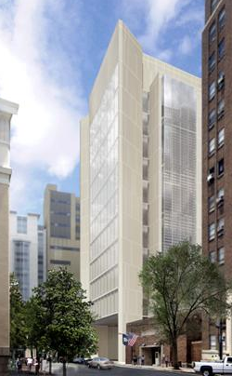
VCU SOM
Acknowledgements
Project Overview
Proposal
Gravity System
Redesign
Vibration Control
Lateral System
Moment Frame Layout
RAM Model
Cost & Schedule Analysis
Architectural Impacts
Conclusions
Gilbane Building Company {MARO}
Nick Ivey
Virginia Commonwealth University
Entire PSU AE Faculty
Professor Linda Hanagan
Professor M. Kevin Parfitt
Family & Friends

Slide 28
VCU SOM
Comments
Project Overview
Proposal
Gravity System
Redesign
Vibration Control
Lateral System
Moment Frame Layout
RAM Model
Cost & Schedule Analysis
Architectural Impacts
Conclusions

